Slide 1


Cyber Security
Celebrating Ag Shows NSW 2023
Proprietary & confidential information. All information commercial in confidence and not to be disclosed to other parties.

Slide 2

Agenda
Cyber Security – Lost in Space
Let’s understand what is Cyber Crime
How it affects you and your show
Some examples
Who has a role to play
How can we can mitigate this risk

Slide 3
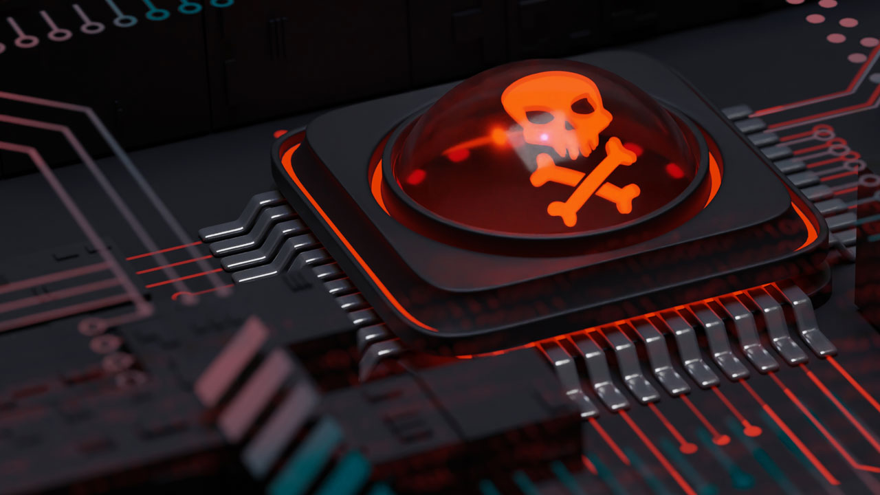
What is Cyber Crime

Slide 4

Malware
What: Malicious software meant to harm or exploit computer systems
i.e. viruses, worms, ransomware
Perpetration:
Email attachments
Malicious websites you may have visited
Infected Software

Slide 5
Phishing, Spoofing and Social Engineering
What: Trickery into revealing sensitive information. Such as fake emails, deceptive websites, impersonation
Perpetration:
Emails received
Phone Calls
Text Messages

Slide 6
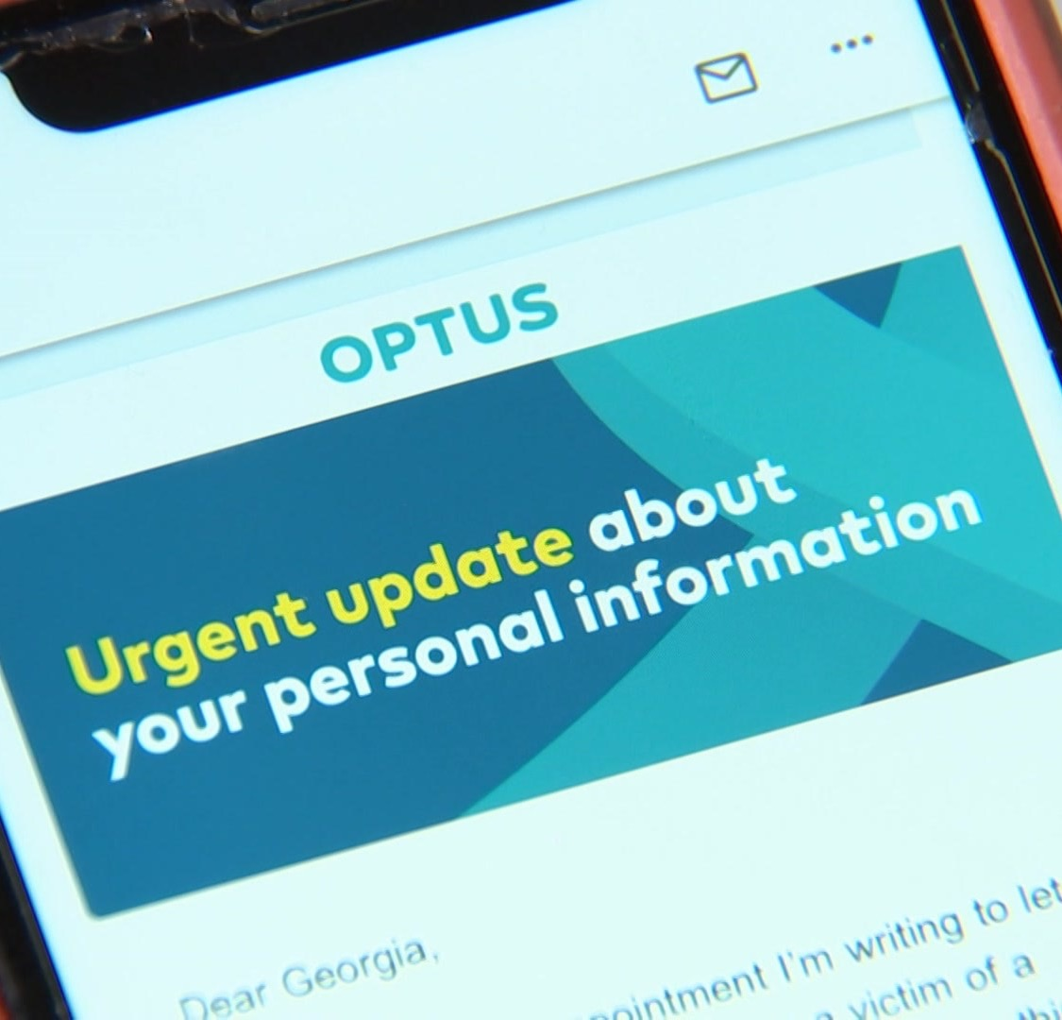
Data Breaches
What: Unauthorised access or disclosure of sensitive information.
i.e stolen passwords, hacking into databases
Perpetration:
Exploiting software vulnerabilities
Weak Passwords
Social Engineering

Slide 7
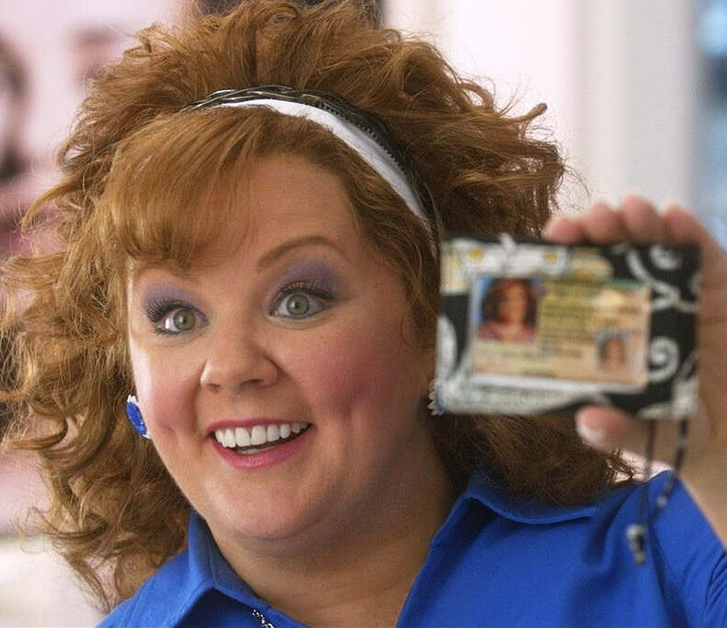
Identity Theft and Fraud
What: Unauthorised use of personal and financial information
i.e credit card fraud, account takeovers
Perpetration:
Phishing
Data breaches
Social Engineering

Slide 8

And more…
Denial of Service Attacks
System overloads, flooding
Insider Threats
Employee leaks, sabotage
Artificial Intelligence
AI, AGI, SHMI

Slide 9
It will never happen to me
We are all being targeted, directly or indirectly
Why:
To seek reward or
To on-sell your data to others so they can then target you
Credit Card Details - $1 a record
Medical Information -$7 a record

Slide 10
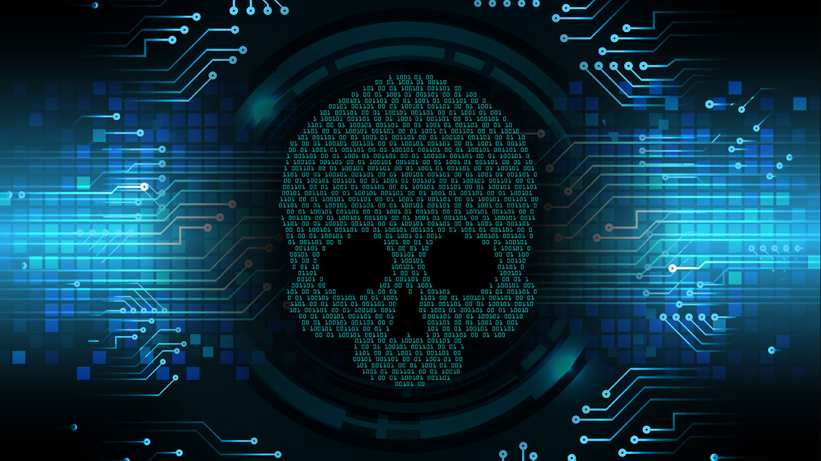
Some Examples

Slide 11
Example 1 - Show ABC
Call receive from Microsoft advising that the Show bank accounts had been illegally accessed
Legitimate material and language used
Added an App to the Show phone enabling the threat actor to monitor keyboard activity. Supported with Telstra phone messaging for updating passwords.
Instructions received to open bank account on phone and then close it, revealing access codes and passwords
Three “dummy” withdrawals done, only to track illegal activity
Loss $28,500

Slide 12
Example 2 – Show XYZ
Hacker accessed email account
Accessed an old invoice and changed the dates, amounts and bank details
Just so happened that a similar amount to the same supplier was expected to be paid
Accounts updated the bank details for payment, seconder authorized
Loss $32,000

Slide 13






Some sobering statistics
Worldwide, consumers
1 in 3
65% of
lost $358
homes
Australians
+21 hours
with computers infected
with malicious software
who went online received at least one online scam offer.
on average per year dealing with online crime.
47%
600,000
The #1 cyber crime
is the imposter scam
of Australian adults
Facebook
Accounts
have had their personal information exposed
by cyber criminals
with 1 in 5 people reporting a
financial loss.
hacked every single day.

Slide 14
Mitigating Cyber Security Risks
Don’t open links in emails unless they are from a trusted source (right mouse click on the actual email address and check the full email address ensuring it is from the actual person)
Don’t action any un-solicited calls. STOP. Tell them you will call them back and call them on the official number.
Do not change bank account details on your supplier records without independent verification with the supplier
Regularly update software and systems (patches)
Implement strong passwords – password managers

Slide 15
Mitigating Cyber Security Risks
Use Multifactor Authentication to access your IT platforms where possible
Exercise caution with downloads and email attachments
Verify requests for sensitive information
Educate your volunteers re: Cyber Threats / Safe Practices
Don’t Be Fooled – Trust No One
Be Suspicious

